Slide 1

Shared Heritage Project

Slide 2
Premise
Christmas has been a shared part of our islands heritage as we have been predominately Christian for a considerable time.
We wanted to utilise the traditions of Christmas present as a vehicle to examine Christmas past and consider Christmas future
We have found that an associated skill/activity supports conversations
X2 tutors 1hr/ week over two weeks
One tutor focussed on facilitated discussion and the other on teaching digital photography skills

Slide 3
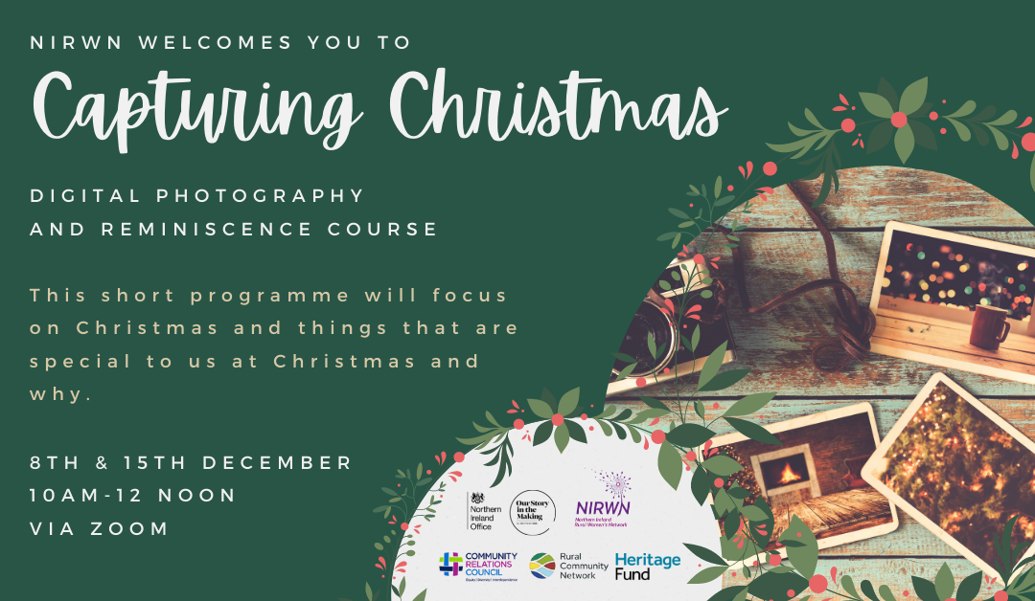
Capturing Christmas

Slide 4
Content-Reminiscence
Which Christmas traditions are carried out in their families? Why?
Historical background to some traditions e.g. tree which are European and pre Christian
When we wish each other a peaceful Christmas what do we mean?
What does peaceful mean to us? Who are the peacemakers?
What is important to us at Christmas; objects, events, food etc
What did we miss during Christmas 2020 that we couldn’t do?
Shared Christian heritage has not meant that our islands have always been peaceful
What might it have been like for families in Christmas1921with partition and families physically and ideologically divided
Welcoming; Christmas story is one of a displaced family. Are we welcoming to the displaced now? Are we welcoming to other traditions? What do we know about other traditions?
How do we envisage Christmas future

Slide 5
Virtual Exhibition
https://www.instagram.com/tv/CX02lF-qJr_/

Slide 6
Find Us
T: @nirwnnews
I: @nirwnnews
F: @nirwnorg
W: www.nirwn.org

